Slide 2
React JS

Slide 3
Introduction
ReactJS is a declarative, efficient, and flexible JavaScript library for building reusable UI components.
ReactJS was created by Jordan Walke, a software engineer at Facebook.
It was initially developed and maintained by Facebook and was later used in its products like WattsApp & Instagram.
Facebook developed ReactJS in 2011 in its newsfeed section, but it was released to the public in the month of May 2013.
ReactJS uses a declarative paradigm that makes it easier to reason about application.
React is not a framework. It is just a library developed by Facebook to solve some problems that developers were facing earlier.

Slide 4
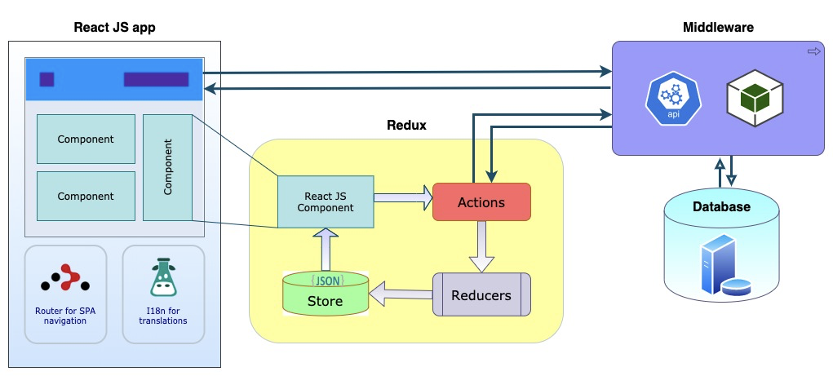
Top–level architecture

Slide 5
contd..
React application is made of multiple components, each responsible for rendering a small, reusable piece of html.
Components can be nested within other components to allow complex applications to be built out of simple building blocks.
A component may also maintain an internal state – for example, a TabList component may store a variable corresponding to the currently open tab.
React architecture consists of three concepts –
React elements – JavaScript representation of html DOM. React provides an API, React.createElement to create React Element.

Slide 6
contd..
JSX – js extension for designing user interfaces. JSX is an XML based, extensible language that supports HTML syntax with slight modifications. JSX stands for JavaScript XML. JSX allows to write HTML in React. JSX makes it easier to write and add HTML in React.
React Component – is a JavaScript class (extends the React Component class) or a pure JavaScript function. components have properties, state management, lifecycle and event handlers. can handle any logic. It uses React Elements and JSX to design its user interface.
The React library is a UI library, doesn't implement any special patterns for writing a complex application. However the React community advocates certain design patterns one is the flux pattern.
React library also provides many concepts like higher order components, context, render props, refs etc. to write better code.
React Hooks is developing concept to do state management in large projects.

Slide 7
contd..
ReactJS designs simple views for each state in application, and efficiently update & render just the right component when the data changes. The declarative view makes the code more predictable and easier to debug.
npm view react version
import React from 'react’
imports the default export of the React library,
import * as React from 'react’
imports all named exports from the React library as an object
When React is imported, the user-code is told to make use of functions and objects provided by React library. This enables us to create and manage components and their state.
Babel is a JavaScript compiler that takes your modern JavaScript code and returns browser compatible JavaScript. It translates JSX into React.createElement calls.

Slide 8
Declarative Paradigm
In declarative programming, the programmer defines the desired result, and the programming language or framework handles the implementation details. This allows programmers to focus on the high-level logic and structure of the problem.
Declarative programming abstracts the control flow for logic, relying on preconfigured capabilities in the language. The programmer expresses the logic of a computation without revealing its control flow or state management.
Declarative programming is commonly used in areas such as:
Database management (SQL)
Configuration management (Puppet, Chef)
Front-end UI design (HTML, CSS)

Slide 9
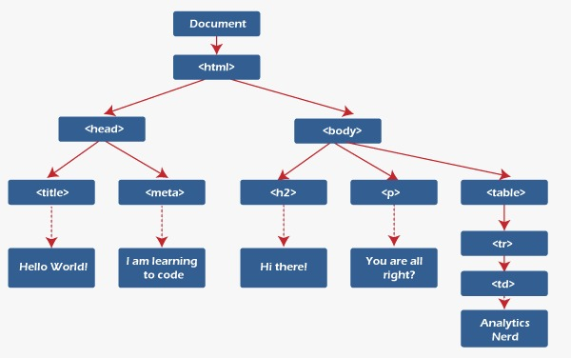
DOM – Document Object Model
DOM stands for Document Object Model, divides into modules and executes the code.
JavaScript updates the whole DOM at once, making the web application slow.
It represents the entire UI(User Interface) of the web application as the tree data structure. React uses virtual DOM which is an exact copy of real DOM.
Whenever there is a modification in the web application, the whole virtual DOM is updated first and finds the difference between real DOM and Virtual DOM.
The DOM is constituted as a tree data structure. It consists of the node for each UI element present in the web document.

Slide 10
Virtual DOM
A React application is made of multiple components, each responsible for rendering a small, reusable piece of HTML.
Components can be nested within other components to allow complex applications to be built out of simple building blocks.
React implements a Virtual DOM that is basically a DOM tree representation in JavaScript.
When it needs to read/write to the DOM, it will use the virtual representation of it. Then the virtual DOM will try to find the most efficient way to update the browser’s DOM.
React efficiently updates and renders the right component when the data changes.
React was conceived to be used in the browser, because of its design it can also be used in the server with Node.js.

Slide 11
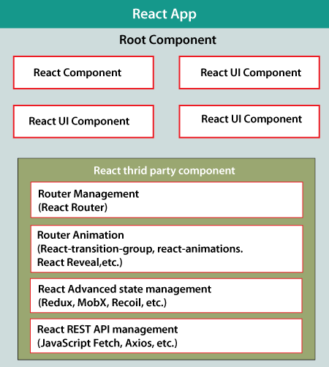
contd..
React app starts with a single root component.
The core component is created by using one or more components.
Most of the components are user interface components. Each component can be nested with any other component at any level.
Component is built by composing smaller components rather than by inheritance. This is called Composition.
React apps may include third-party components for a specific purpose, such as routing, animation, state management, etc.

Slide 12
Getting started
IDE – Visual Studio
NodeJS and npm are the platforms needed to develop ReactJS application.
create–react–app is a tool maintained by Facebook to install react. Using this, there is no need to manually having to deal with transpiling tools like webpack and babel.
Install React using npm package manager. The create–react–app npm package will take care of complexity of ReactJS installation.
c:\Temp–React\>npm install -g create–react–app
After installation, create a new react project create–react–app command.
c:\Temp–React\>npx create–react–app sample-reactapp1

Slide 13
contd..
Note : The above two steps can be combined in a single command using npx. npx is a package runner tool that comes with versions npm 5.2 and above. .\npx create–react–app Sample-ReactApp1
This will install the react and create a new project with the name Sample-ReactApp1.
To get started, open the src folder and make changes in desired file.
After completing the installation process, start the server by running the following command.
c:\Temp–React\> cd Sample-ReactApp1
c:\Temp–React\ Sample-ReactApp1 >npm start

Slide 14
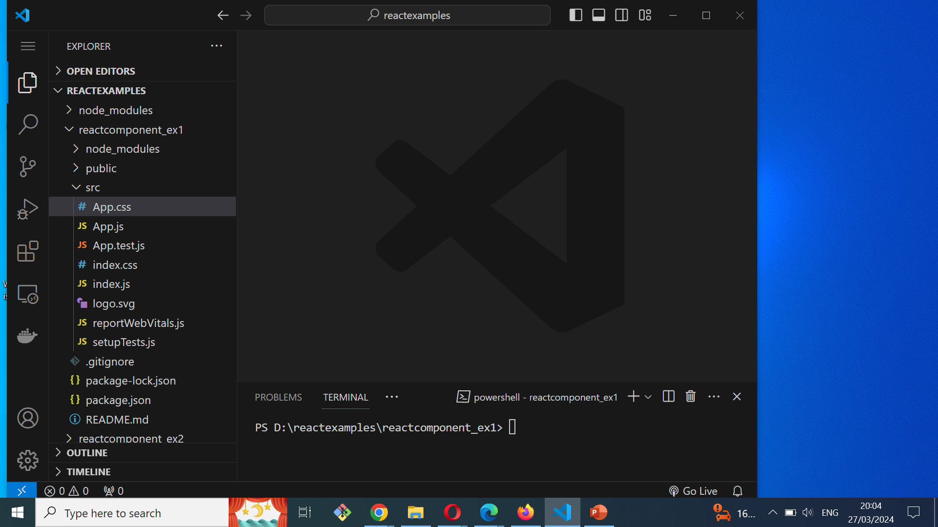
contd..

Slide 15
contd..
In React application, there are several files and folders in the root directory. Some of them are as follows:
node_modules: It contains the React library and any other third party libraries needed.
public: It holds the public assets of the application. It contains the index.html where React will mount the application by default on the <div id="root"></div> element.
src: It contains the App.css, App.js, App.test.js, index.css, index.js, and serviceWorker.js files. Here, the App.js file always responsible for displaying the output screen in React.
package-lock.json: It is generated automatically for any operations where npm package modifies either the node_modules tree or package.json. It cannot be published. It will be ignored if it finds any other place rather than the top-level package.
package.json: It holds various metadata required for the project. It gives information to npm, which allows to identify the project as well as handle the project?s dependencies.
README.md: It provides the documentation to read about React topics.

Slide 16
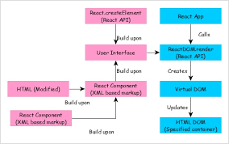
Flow Diagram
The React app calls the reactdom.render method, bypassing the user interface created using the React component (coded in JSX or React Elementor format) and the container to render the user interface.
ReactDOM.render processes JSX or React Elements and emits virtual DOM.
The virtual DOM will be merged and rendered in the container.

Slide 17
ReactDOM
Virtual DOM is a DOM representation of UI in JavaScript and it will be stored in a memory to make comparisons when the render is called.
The Virtual DOM can be referred to as a copy of the actual DOM representation.
Re–rendered DOM is one which gets created when the render method is being called and it will be used to compare with virtual DOM.
It holds the updates made by the user and finally reflect it over to the original Browser DOM.
ReactDOM is a package that provides DOM specific methods.
The package is used at the top level of a web app to enable an efficient way of managing DOM elements of the web page.

Slide 18
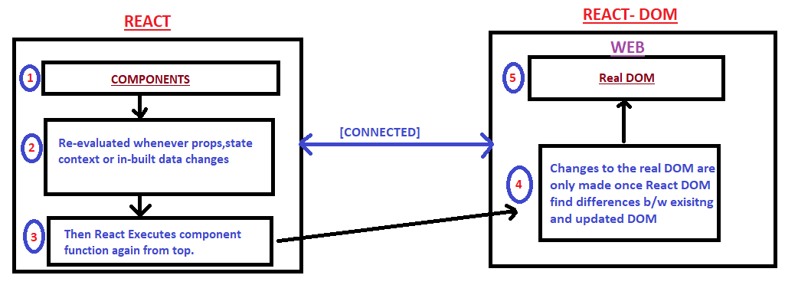
contd..

Slide 19
contd..
ReactDOM provides the developers with an API containing the following methods and a few more.
render()
findDOMNode()
unmountComponentAtNode()
hydrate()
createPortal()
Return Type: This function returns a reference to the component or null if a stateless component was rendered.
How DOM updates in React:
On the first run, both virtual DOM and real DOM tree are created
The nodes in virtual DOM are updated. (React works on observable patterns, hence, whenever there is a change in the state ).
Then, react compares virtual DOM with the real DOM and updates the changes. This process is called reconciliation.
React uses a heuristic algorithm called the Diffing algorithm for reconciliation based on these assumptions:

Slide 20
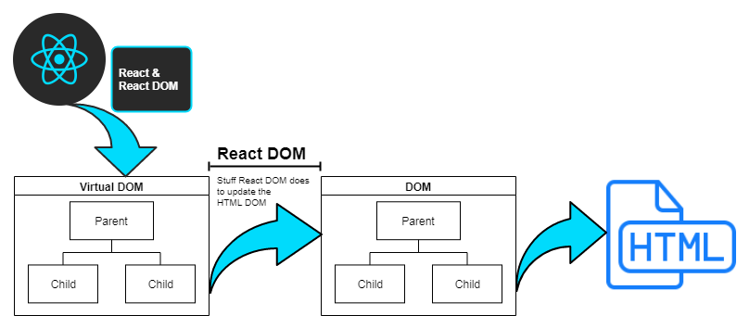
contd..

Slide 21
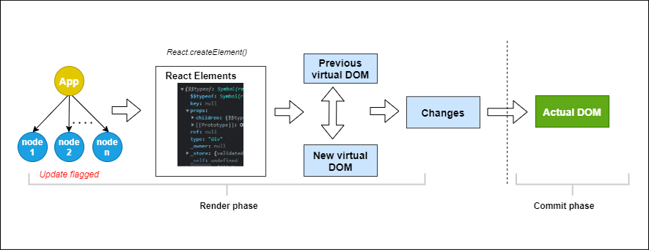
contd..

Slide 22
React elements
The React.createElement() method is a tool for creating React elements.
React elements are the building blocks of React applications, representing the nodes of the virtual DOM that React uses to efficiently update and render user interfaces.
The createElement() method provides deeper insight into how React works under the hood and allows for more dynamic and programmatic element creation.
A React Element is the smallest building block of a React app and it describes what you want to see on the screen. Not to be confused with browser DOM elements, React Elements are plain objects and are cheap to create.
<div className="App"> <h1>Hello, World!</h1> </div>
React.createElement( "div", { className: "App" }, React.createElement("h1", null, "Hello, World!")

Slide 23
contd..
createElement lets you create a React element. It serves as an alternative to writing JSX. createElement method is a fundamental API used to create React elements, which are lightweight representations of DOM elements or custom components.
Syntax and Usage
createElement(type , props , …children)
The createElement method takes three primary arguments:
Type: The type of the element to create. This can be a string representing an HTML tag name (e.g., 'div', 'span'), a React component (class or functional component), or a React fragment (React.Fragment).
Props: An object containing properties (attributes) to assign to the element or component. These can include event handlers, styles, or custom data.
Children: Optional additional arguments that represent the children of the element. These can be further React elements, strings, or numbers.

Slide 24
JSX – JavaScript XML
JSX is a syntax extension for JavaScript that lets you write HTML-like markup inside a JavaScript file.
JSX (JavaScript XML) syntax is more commonly used for its readability and conciseness.
JSX is a syntax extension for JavaScript that lets developer write HTML – like markup inside a JavaScript file.
JSX is Facebook’s xml–like syntax extension to JavaScript, not a language per se unlike typescript which is a language a syntactic– superset of JavaScript.
JSX is a syntax extension of regular JavaScript and is used to create React elements. These elements are then rendered to the React DOM.
React code is written in JSX. Its faster than normal JS as it performs optimizations while translating to regular JS making it easier to create templates.
Normal JS expressions with JSX. To embed any JavaScript expression in JSX code, wrap that expression in curly braces {}.
JSX allows to use attributes with the HTML elements. However unlike the naming convention of HTML, JSX uses camel case convention for attributes

Slide 25
Comparison of JSX and createElement()
One of the key differences between JSX and `React. createElement()` is that JSX lets you write your HTML-like code directly in your JavaScript file. On the other hand, with `React. createElement()` , you need to pass the element type, props, and children as separate arguments.
JSX can make our code more concise and easier to read. However, some developers prefer using `React.createElement()` because it is more explicit and closer to standard JavaScript syntax. It's really a matter of personal preference and what works best for your project.

Slide 26
Code comparison
function ComponentWithCreateElement() { const props = { style: { color: "red" }, onClick: (e) => e.target.innerText = 'Clicked', }; return React.createElement("div", null, [ React.createElement("button", props, "Component with createElement"), ]); }
function ComponentWithJSX() { const style = { color: "green" }; const handleClick = (e) => e.target.innerText = 'Clicked'; return ( <div> <button style={style} onClick={handleClick}> Component with JSX </button> </div> ); }

Slide 27
Props
Props are arguments passed into React components. Props are passed to components via HTML attributes. props stands for properties.
Props in React are the objects used to pass data/information to a Component. It is short for Properties. It is responsible for passing the data ...
Props is a special keyword in React that stands for properties and is used for passing data from one component to another. Data with props are passed in a unidirectional flow from parent to child.

Slide 28
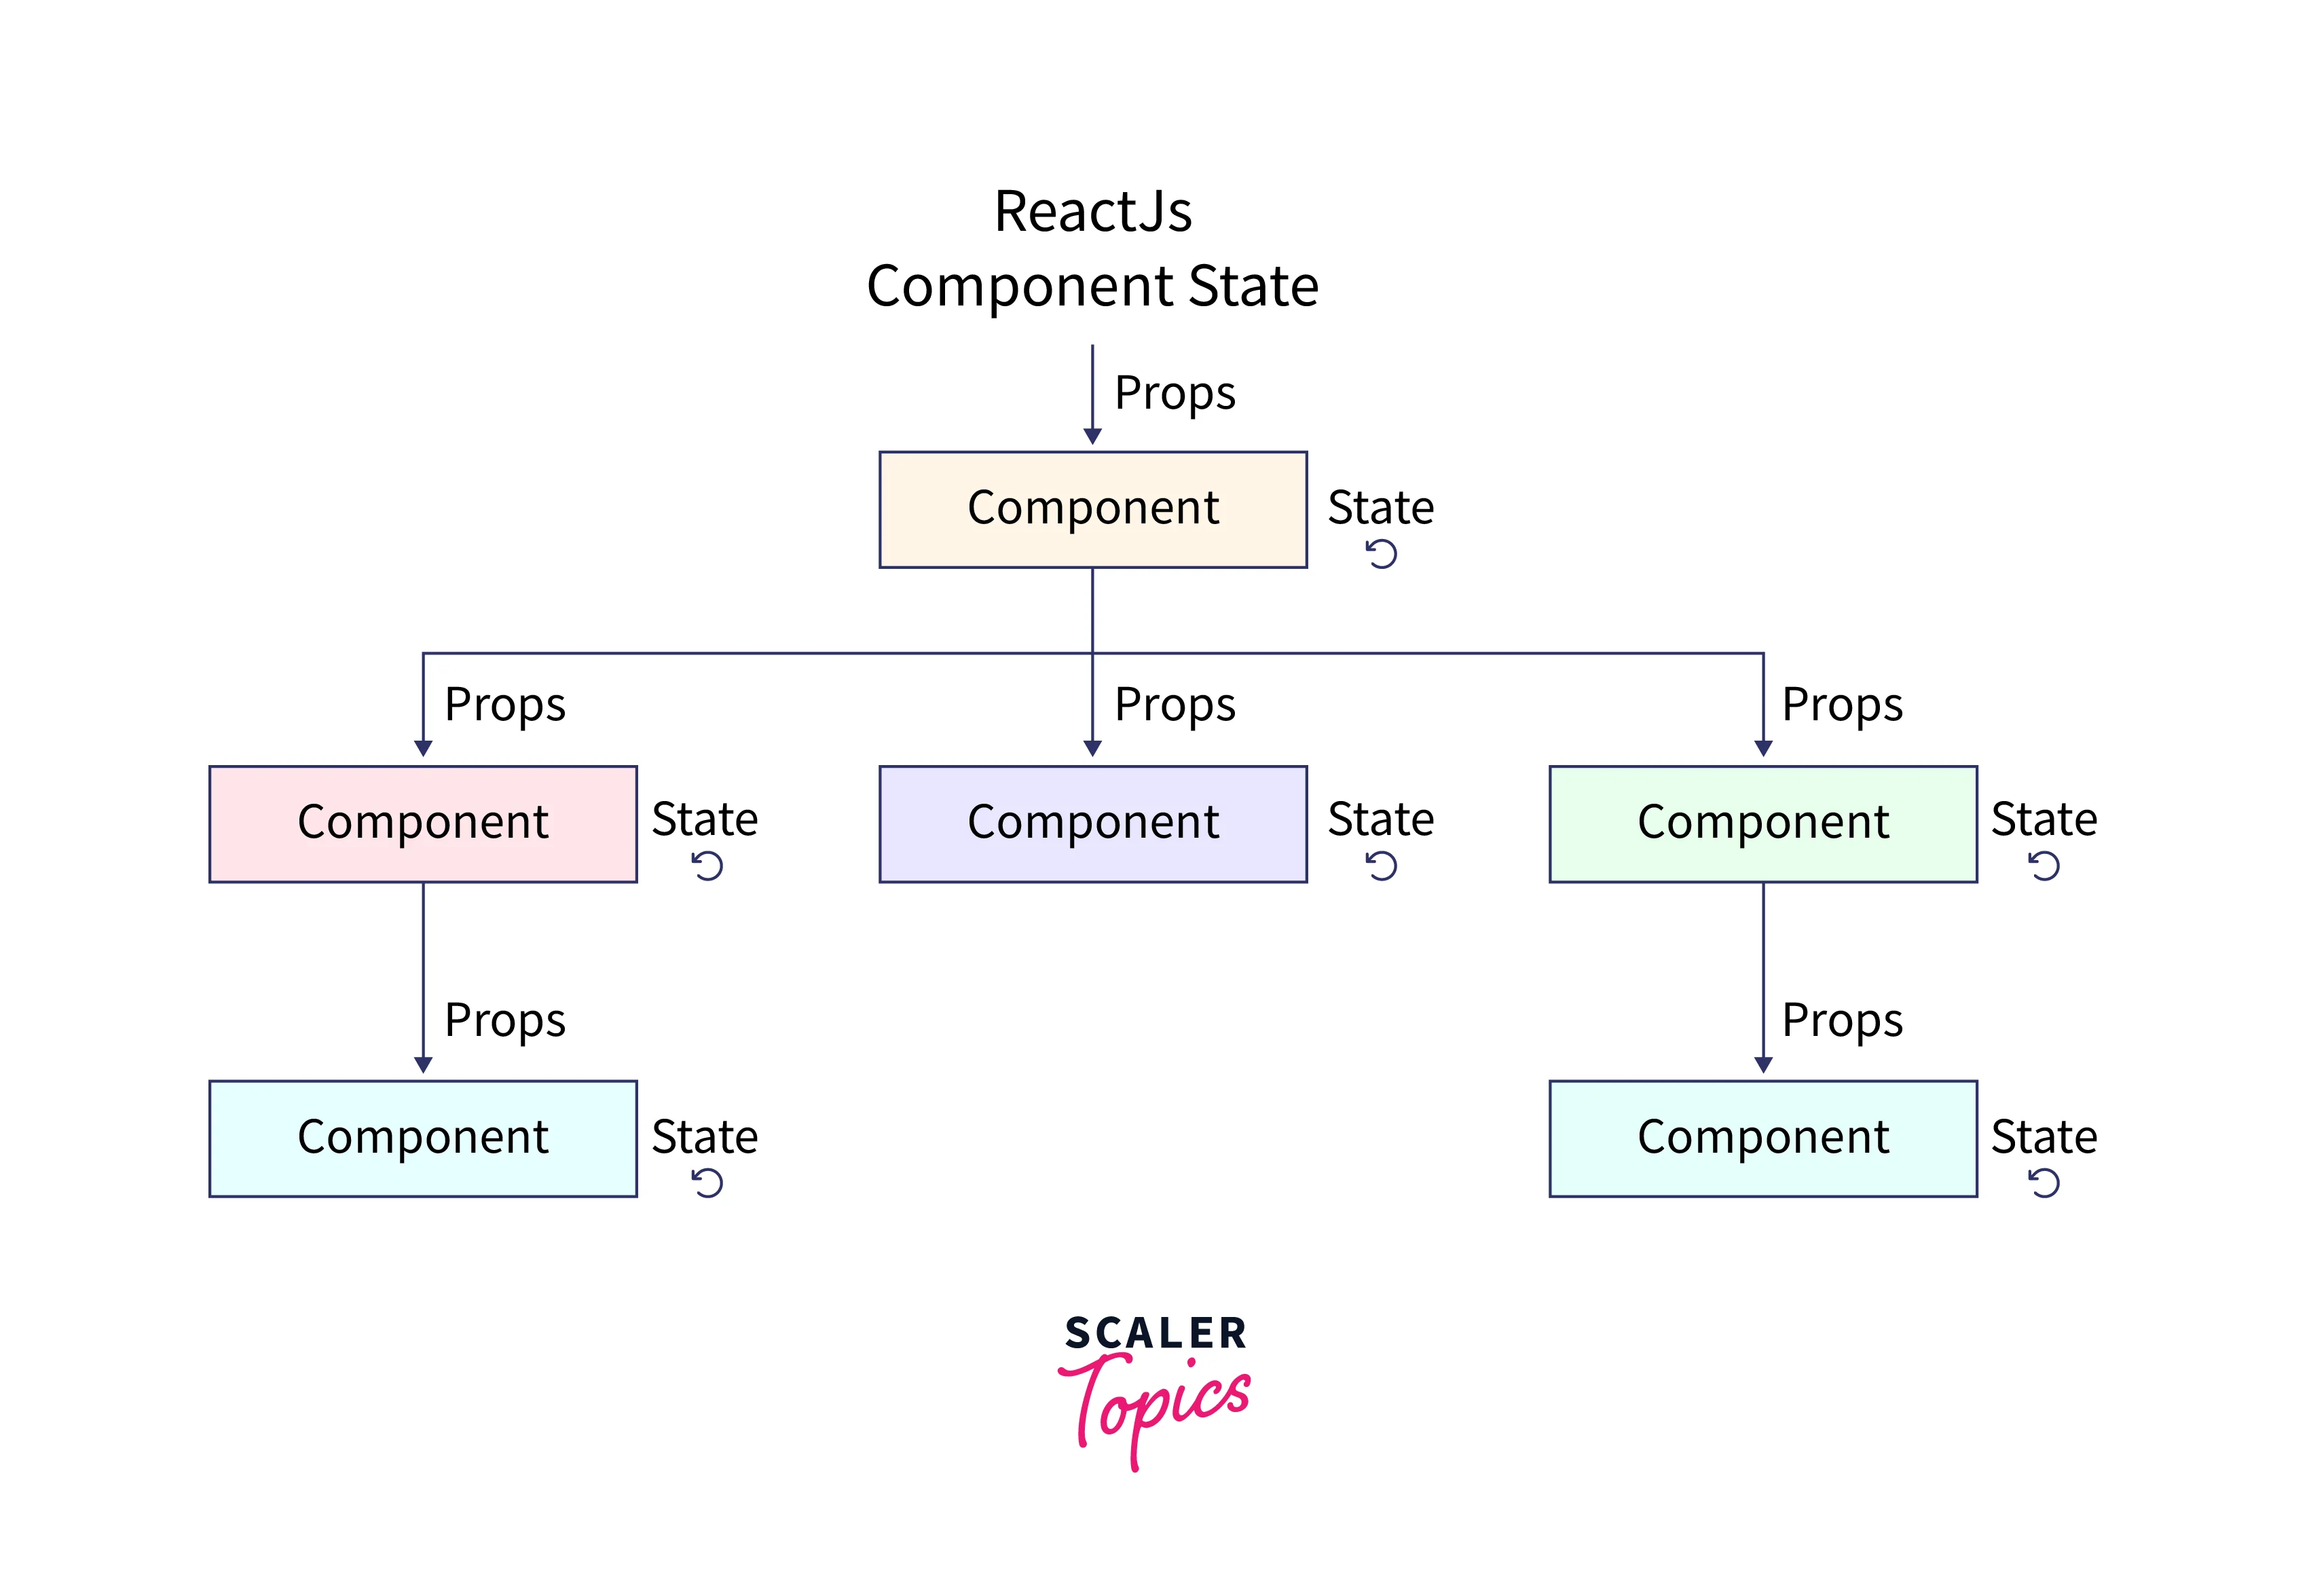
React State
The state in React is an instance of the React Component Class that can be defined as an object of a set of observable properties that control the behavior of the component.
In other words, the State of a component is an object that holds some information that may change over the lifetime of the component.
React components has a built-in state object. The state object is where you store property values that belong to the component.
Due to modularization in React, state serves as a container that encapsulates relevant data, logic, and behavior within a component.

Slide 29
contd..
There is a constant flow of dynamic data through react components.
To manage the dynamic nature of data, there are state objects. The state object is used to store and manipulate the changing data of any component. State also ensures the re-rendering of the component to the browser in case of any change.
Hence, the User Interface in React applications becomes a function of the state. This makes the knowledge about state objects and their handling important.
State in react refers to a javascript object that holds the changing data of any components and also keeps track of those changes over time between different renders. Because of the dynamic nature of the state, it allows users to make dynamic and more interactive web apps. We can use the state to take inputs and capture changing data from API's.
class components use the state property, while the new function component use hooks to manage the state. Learning state management in class components will help you troubleshoot state management based code and give you an understanding of when we have to make use of class components or functional components.

Slide 30
contd..
The useState() hook can conveniently hold strings, arrays, numbers, objects and much more.
The useState() hook works by handling and managing state in applications.
The useState() hook takes the first (initial) value of the state variable as its argument. The second value then sets your state, initiated as setState.
Step 1 : import { UseState } from 'react’;
Step 2 : The useState() hook takes the first (initial) value of the state variable as its argument. The second value then sets your state, which is why it's always initiated as setState.
const [state, setState] = useState(initial values goes here)
const [calories, setCalories] = useState(initial value of calories)

Slide 31
useEffect()
The useEffect hook is used to perform side effects in your functional components, such as
fetching data,
subscribing to external events, or
manually changing the DOM.
It combines the functionality of componentDidUpdate, and componentWillUnmount in class components.

Slide 32
useReducer()
The useReducer Hook is used to store and update states, just like the useState Hook.
It accepts a reducer function as its first parameter and the initial state as the second.
useReducer returns an array that holds the current state value and a dispatch function to which user can pass an action and later invoke it.

Slide 33
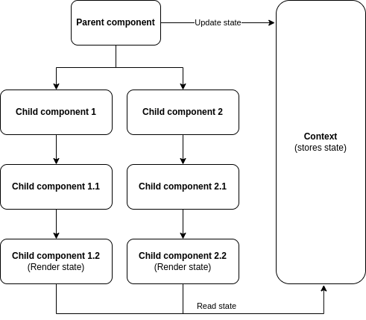
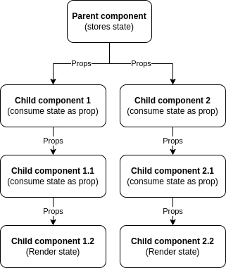
useContext()

Slide 34
useMemo()
useMemo is a valuable tool in the React framework, designed to optimize performance by memoizing expensive computations.
With useMemo, React can store the result of a function call and reuse it when the dependencies of that function haven't changed, rather than recalculating the value on every render.
useMemo is a handy tool in React that helps make your apps faster.
The useMemo and useCallback Hooks are similar. The main difference is that useMemo returns a memoized value and useCallback returns a memoized function. You can learn more about useCallback in the

Slide 35
useCallback()
useCallback hook returns a memoized function to reduce unnecessary callbacks. This useCallback hook is used when you have a component in which the child is rerendering again and again without need.

Slide 36
React Components
Loaded: 100.00%
The entire application is divided into a small logical group of code, which is known as components.
Each component exists in the same space, but they work independently from one another and merge all in a parent component, which will be the final UI of the application.
Every React component have their own structure, methods as well as APIs. They can be reusable as per the need.
ReactJS has two types of components –
Functional Components
Class Components

Slide 37
Functional Components
Functional components provide a way to write components that only contain a render method and don't have their own state.
They are simply JavaScript functions that may or may not receive data as parameters.
Create only a function that takes props(properties) as input and returns what should be rendered. A valid functional component is as shown in the below example.
function WelcomeMessage(props) {
return <h1>Welcome to the , {props.name}</h1>;
}
The functional component is also known as a stateless component because they do not hold or manage state. It can be explained in the below example.

Slide 38
Class Components
Class component requires to extend from React.Component and create a render function returning a React element.
Also a class can be defined by extending Component and has a render function.
Data can be passed from one class to other class components.
class MyComponent extends React.Component {
render() {
return (
<div>This is main component.</div>
);
}
}
The class component is also known as a stateful component because they can hold or manage local state.

Slide 39
contd..
The components created of the two types are equivalent, and also the basic difference between a functional component and class component.
Functional component is used only when the component does not require interacting or working with any other component i.e. these components do not require data from other components
Multiple functional components can be composed under a single functional component.
Class components can also be used for this purpose but it is not recommended if there is no need will make the application in-efficient.

Slide 40
A class component can be called in a functional component in React. This is achieved by using the React Hooks API, specifically the useState and useEffect hooks.

Slide 41
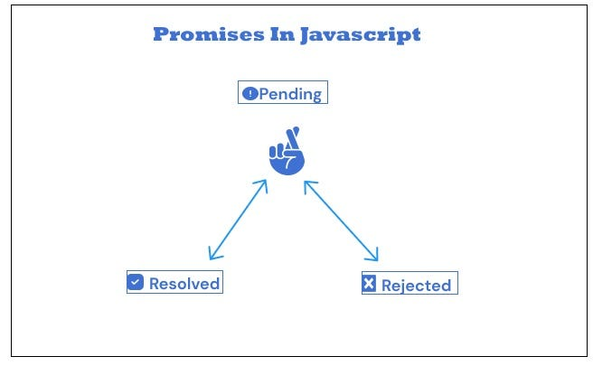
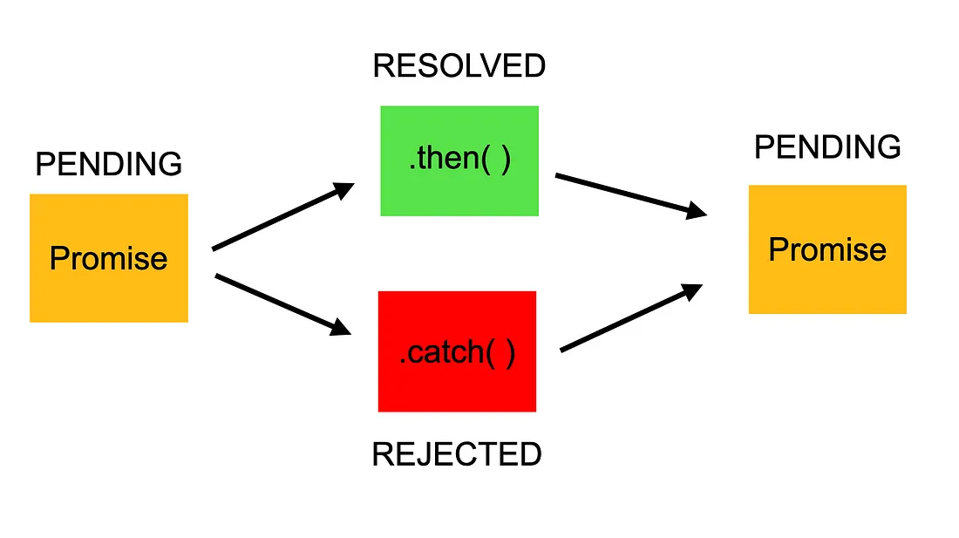
Promises

Slide 42
contd..
A promise is an object that may produce a single value sometime in the future. Either a resolved value or a rejected value.
A promise is a good way to handle asynchronous operations. It is used to find out if the asynchronous operation is successfully completed or not.
Promise makes JavaScript behave asynchronously, which makes this language versatile.
Promise has three possible states:
Pending: You don’t know if you will gain 10kg by the next month.
Resolved/Fulfilled: You gained10kgs by the next month.
Rejected: You don’t gain weight at all.
A promise starts in the pending state, which indicates that the Promise hasn’t been completed yet. It ends with either resolved/fulfilled (successful) or rejected (failed) state.

Slide 43
contd..
To create a promise object, use the Promise() constructor.
let promise = new Promise(function(resolve, reject)
{ //do something });
The Promise() constructor takes a function as an argument. The function also accepts two functions resolve() and reject().
If the promise returns successfully, the resolve() function is called. And, if an error occurs, the reject() function is called.

Slide 44
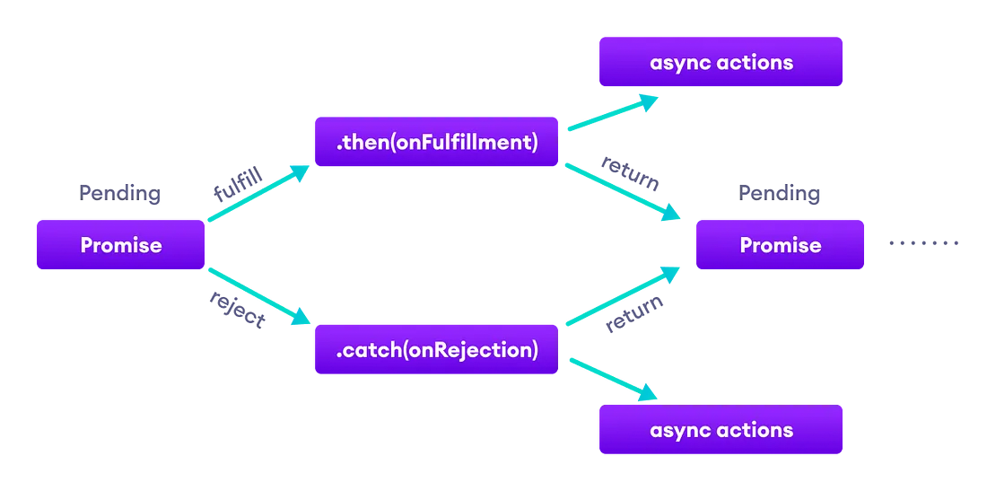
contd..
Diagram for program6

Slide 45
contd..
Benefits of Promises
Improves Code Readability
Better handling of asynchronous operations
Better flow of control definition in asynchronous logic
Better Error Handling

Slide 46
Axios
Axios is a library used to create HTTP requests to external resources.
In React.js, using Axios allows user to make HTTP requests to APIs and other external resources.
It is a popular library for making HTTP requests in JavaScript applications because it provides a simple API and supports Promises.

Slide 47
Advantages of Axios
JSON Data Handling: Axios automatically parses JSON responses, eliminating the need for manual parsing. This simplifies working with APIs that return JSON data and reduces boilerplate code.
Built-in CSRF Protection: Axios provides built-in support for CSRF protection through configuration options for setting headers like X-CSRF-Token. This helps developers guard against Cross-Site Request Forgery attacks without needing to implement custom solutions.
Request and Response Interceptors: Axios allows you to define interceptors for both requests and responses. Interceptors provide a way to add global error handling, modify request or response data, set headers, log requests, and more. This capability enhances code modularity and simplifies tasks that would otherwise require repetitive boilerplate code.

Slide 48
Explanation of program – 3
useState Hook: Use the useState hook to manage the state of your data (data in this example), which will store the fetched API response.
useEffect Hook: Use the useEffect hook to perform side effects in your functional component. Here, Axios GET request is made inside useEffect with an empty dependency array ([]) to ensure it runs once when the component mounts.
Axios GET Request: Use axios.get to make a GET request to the specified API endpoint (https://jsonplaceholder.typicode.com/posts). Axios returns a Promise, so you can chain .then() to handle the successful response and .catch() to handle errors.
Updating State: Update the data state with the fetched data using setData(response.data).
Rendering Data: Render the fetched data (data.map) in your JSX. In this example, it renders a list of post titles fetched from the API.

Slide 49
Explanation of program – 4
useState Hook: Initializes postData state to hold the form data (title and body) that will be sent in the POST request.
handleSubmit Function: This function is called when the form is submitted (onSubmit event). It prevents the default form submission behavior (e.preventDefault()) and then makes a POST request using Axios.
axios.post: Sends a POST request to the specified URL (https://jsonplaceholder.typicode.com/posts in this case) with the postData object as the data payload. Axios automatically serializes the data to JSON format.
Handling Response: The .then() block handles the response returned by the server after the POST request is successfully processed. In this example, it logs the response data to the console. You can also update the component state, display a success message, or perform other actions based on the response.

Slide 50
contd..
Error Handling: The .catch() block catches any errors that occur during the POST request (e.g., network issues, server errors). It logs the error to the console for debugging purposes. Depending on your application’s requirements, you can display error messages to users or implement other error handling logic.
handleChange Function: Updates the postData state as the user types into the form inputs (onChange event). This ensures that the postData object reflects the current values of the form inputs.

Slide 51
Unit Testing in React
Testing involves checking if your code is functioning as it's supposed to by comparing the expected output with the actual output.
Tests should cover the following aspects of your code:
If a component renders with or without props
How a component renders with state changes
How a component reacts to user interactions
Things do not need to test:
Actual Implementation: The actual implementation of a functionality need not be tested. Only if component is behaving correctly needs to be seen. E.g. Sort an array on the click of a button. No need to test the actual sorting logic. Only see if the function was called and if the state changes are rendering correctly.
Third Party libraries: Any third party libraries like Material UI, no need to test.

Slide 52
Thank You !

